Slide 1
Dynamic Programming

Slide 2
Introduction
Dynamic programming is a methodology that often yield polynomial time algorithms; it solves problems by combining the results of solved overlapping subproblems.
To understand what overlapping subproblems are, let’s start with the maybe most popular example when it comes to dynamic programming — calculate Fibonacci numbers.

Slide 3
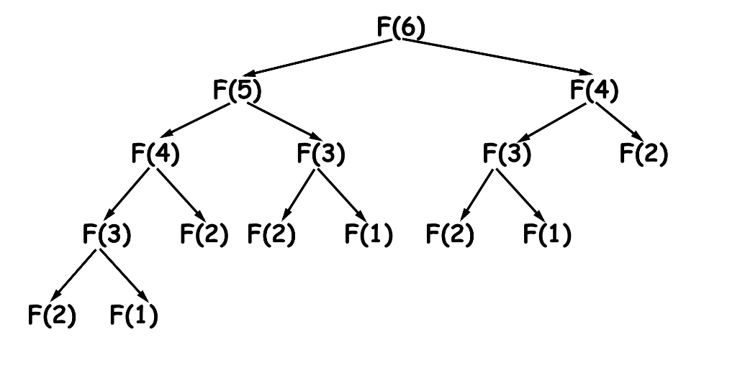
Introduction
Fibonacci numbers are number that following fibonacci sequence, starting form the basic cases F(1) = 1(some references mention F(1) as 0), F(2) = 1. F(n) = F(n-1) + F(n-2) for n larger than 2.
To calculate F(n) for a giving n:
What’re the subproblems? Solving the F(i) for positive number i smaller than n, F(6) for example, solves subproblems as the diagram.
What’re the overlapping subproblems? From the diagram, there are some subproblems being calculated multiple times. By caching the results, we make solving the same subproblem the second time effortless.

Slide 4
Introduction
Another property of Dynamic Programming is : Optimal Substructure property
A given problem has Optimal Substructure Property, if the optimal solution of the given problem can be obtained using optimal solutions of its sub-problems.
We’ll see the practical implementation of this property in upcoming optimization DP problems.

Slide 5
Introduction:
There are following two different ways to store the values so that these values can be reused:
Memoization (Top-down approach): start with the original problem(F(n) in this case), and recursively solving smaller and smaller cases(F(i)) until we have all the ingredient to the original problem. Tabulation (Bottom-up approach): start with the basic cases(F(1) and F(2) in this case), and solving larger and larger cases.

Slide 6
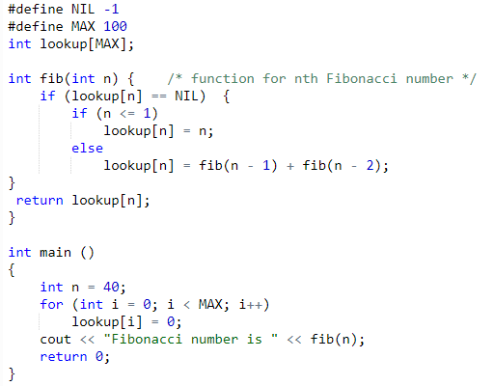
Memoization
The memoized program for a problem is similar to the recursive version with a small modification that it looks into a lookup table before computing solutions. We initialize a lookup array with all initial values as “Empty”. Whenever we need the solution to a subproblem, we first look into the lookup table. If the precomputed value is there then we return that value, otherwise, we calculate the value and put the result in the lookup table so that it can be reused later.

Slide 7
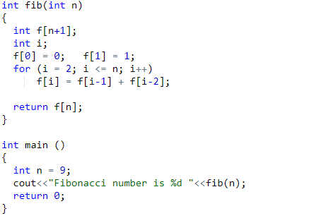
Tabulation
The tabulated program for a given problem builds a table in bottom up fashion and returns the last entry from table. For example, for the same Fibonacci number, we first calculate fib(0) then fib(1) then fib(2) then fib(3) and so on. So literally, we are building the solutions of subproblems bottom-up.

Slide 8
Steps of Dynamic Programming Approach
Dynamic Programming algorithm is designed using the following four steps −
Characterize the structure of an optimal solution. (if applicable)
Recursively define the value of an optimal solution.
Compute the value of an optimal solution, typically in a bottom-up fashion. (or top-down)
Construct an optimal solution from the computed information.
Example : Recursive : F(n) = F(n-1) + F(n-2)
Top down : int f[n+1] -> f[n] = f[n-1]+f[n-2]
Optimised: int f1=1, f2 =1
for(i=3->n)
f_curr = f1 + f2
f2 = f1
f1 = fcurr

Slide 9
Patterns of DP
Minimum (Maximum) Path to Reach a Target
Distinct Ways
Merging Intervals
DP on Strings
Decision Making

Slide 10
Pattern 1: Minimum (Maximum) Path to Reach a Target

Slide 11
Problems on DP:
Problem Statement: On a staircase, the i-th step has some non-negative cost cost[i] assigned (0 indexed).
Once you pay the cost, you can either climb one or two steps.
You need to find minimum cost to reach the top of the floor, and you can either start from the step with index 0, or the step with index 1.
Example 1: Input: cost = [10, 15, 20] Output: 15 Explanation: Cheapest is start on cost[1], pay that cost and go to the top.
Example 2: Input: cost = [1,11,16,3] f(n) = min(f(n-1),f(n-2)) + cost[n]

Slide 12
Problem 1: Solution
Step 1 - Identify a recurrence relation between subproblems. In this problem,
Recurrence Relation:
mincost(i) = cost[i]+min(mincost(i-1), mincost(i-2))
Base cases:
mincost(0) = cost[0]
mincost(1) = cost[1]
Cost = {1,11,5,3}

Slide 13
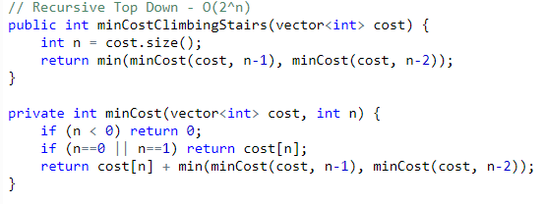
Problem 1: Recursion
Step 2 - Covert the recurrence relation to recursion

Slide 14
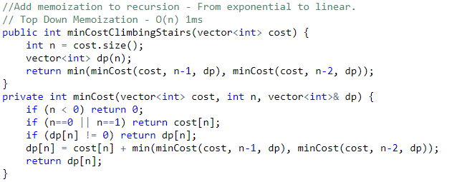
Problem 1: Top down DP
Step 3: Optimization 1 - Top Down DP - Add memoization to recursion
For(i=0;i<n;i++)
{
dp[i]=cost[i]+min(dp[i-1],dp[i-2])
}

Slide 15
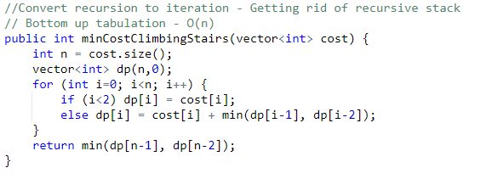
Problem 1 : Bottom Up DP
Step 4 - Optimization 2 -Bottom Up DP - Convert recursion to iteration

Slide 16
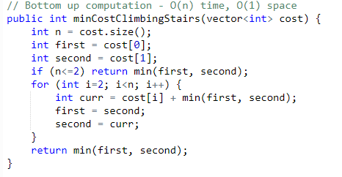
Problem 1: Space Optimization
Step 5 - Optimization 3 - Fine Tuning - Reduce O(n) space to O(1).
Cost [1,11,16,3]
First = 1;
Second = 11;
i=2
Curr = 16 + min(1,11) = 16+1=17
First = 11
Second = 17

Slide 17
Pattern 2: Distinct Ways

Slide 18
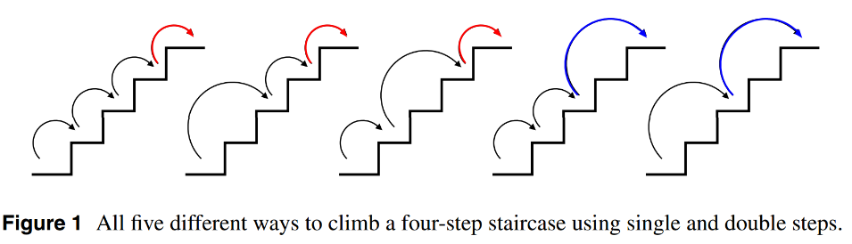
Problem 2: Ways to Climb Stairs
Problem Statement: You are climbing a stair case. It takes n steps to reach to the top.
Each time you can either climb 1 or 2 steps. In how many distinct ways can you climb to the top?
Ways[n] = ways[n-1]+ways[n-2];
Int climbStairs(int n)
{
if(n<=0)
return 1;
if(n==1)
return 1;
return climbStairs(n-1)+climbStairs(n-2);
}

Slide 19
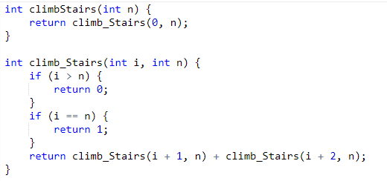
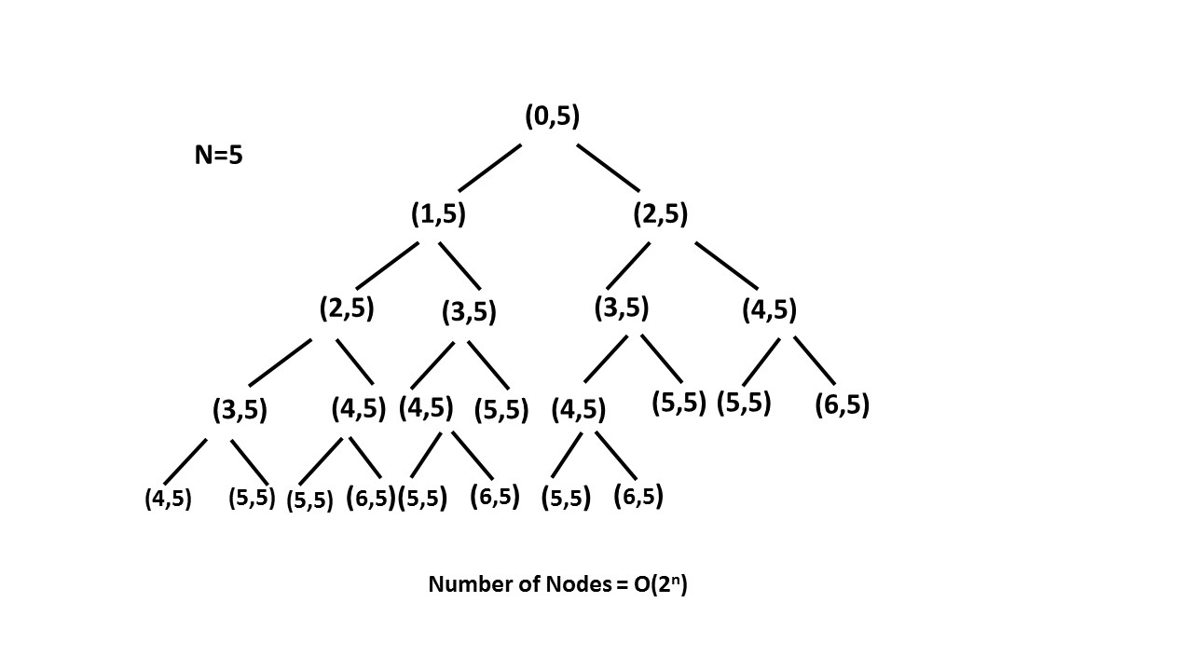
Problem 2 : Recursion
N=5
i=0 -> fun(1,5)+fun(2,5)
i=1 -> fun(2,5) + fun(3,5)
i=2 -> fun(3,5) + fun(4,5)
i=3 -> fun(4,5) + fun(5,5)
i=4 -> fun(5,5) + fun(6,5)
i=5 -> 1
Time complexity : O(2^n)
Space complexity : O(n). The depth of the recursion tree can go upto n.

Slide 20
Ways[n] = ways[n-1]+ways[n-2];
Int climbStairs(int n)
{
if(n<=0)
return 0;
if(n==1)
return 1;
return climbStairs(n-1)+climbStairs(n-2);
}

Slide 21
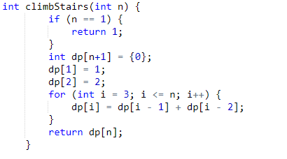
Problem 2: DP Approach
Time complexity : O(n). Single loop upto n.
Space complexity : O(n). dp array of size n is used.

Slide 22
Pattern 3: Merging Intervals

Slide 23
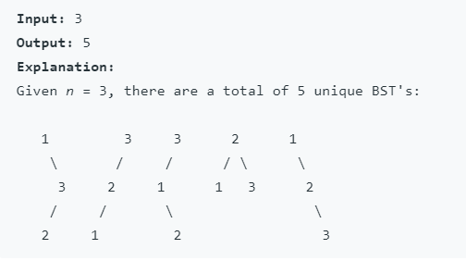
Problem 3: Unique BST
Problem Statement:
Given n, how many structurally unique BST's (binary search trees) that store values 1 ... n?
Example:
3
2 4
1 5
3
2 4
1

Slide 24
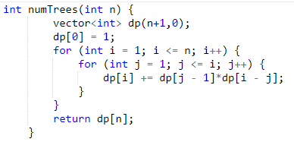
Problem 3: DP Approach
Dp [1,1,2, 5]
Time complexity : O(n^2).
Space complexity : O(n). dp array of size n is used.

Slide 25
Pattern 4: DP on Strings

Slide 26
Problem 4: Longest Common Subsequence
Problem Statement:
Given two strings text1 and text2, return the length of their longest common subsequence.
A subsequence of a string is a new string generated from the original string with some characters(can be none) deleted without changing the relative order of the remaining characters. (eg, "ace" is a subsequence of "abcde" while "aec" is not).
A common subsequence of two strings is a subsequence that is common to both strings.
If there is no common subsequence, return 0.

Slide 27
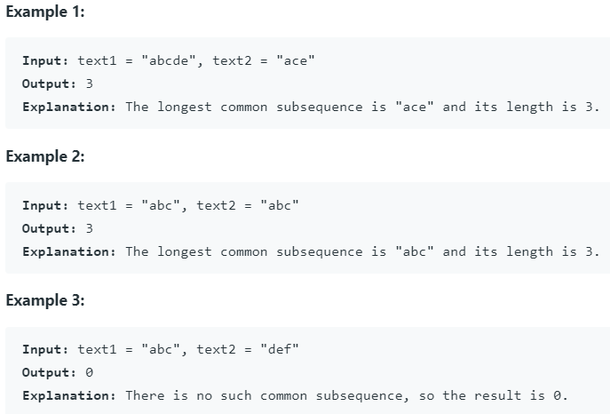
Problem 4 : LCS contd

Slide 28
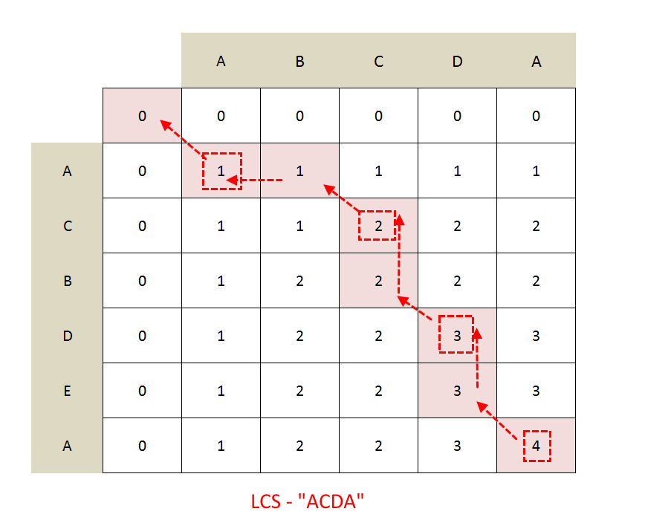
Visualization of Solution
S1 = {}
S2 {A}
------
S1 {A}
S2 {}
----
S1 {A}
S2 {A}

Slide 29
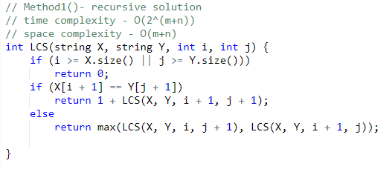
Problem 4 : Recursive Solution
Example : X = A B C D E
Y = A C E
Answer : 3 ie ace

Slide 30
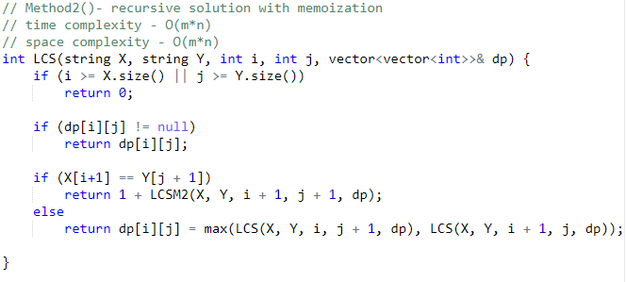
Problem 4: Memoization

Slide 31
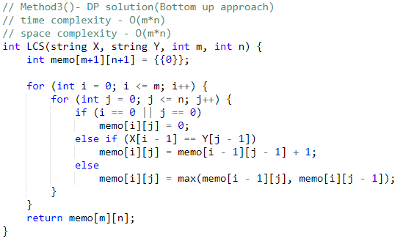
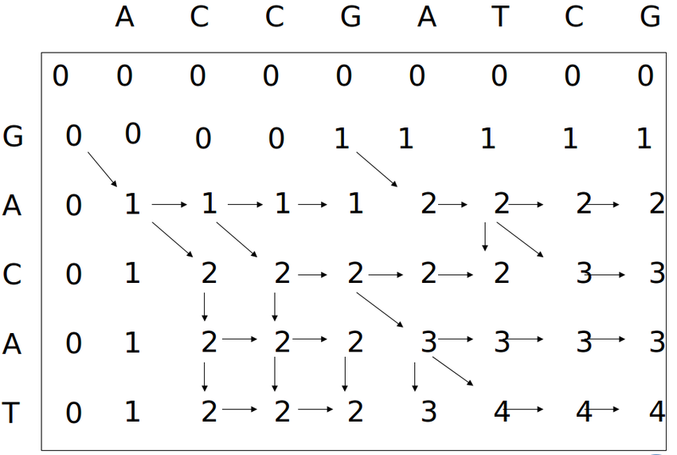
Problem 4: Tabulation

Slide 32
Pattern 5: Decision Making

Slide 33
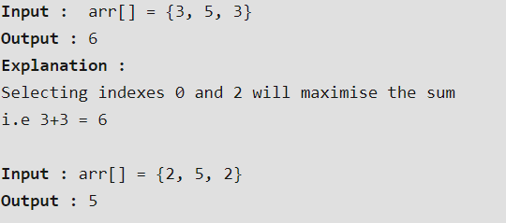
Problem 5: Max Sum Non-Contiguous
Problem Statement:
Given an array of positive numbers, find the maximum sum of a subsequence with the constraint that no 2 numbers in the sequence should be adjacent in the array.
Example:

Slide 34
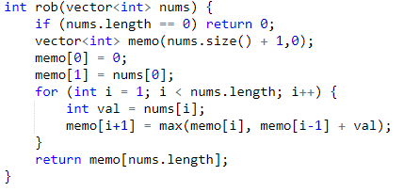
Problem 5: DP Approach
memo
Memo[0] = 0
Memo[1]=3
Memo[2]=5
Memo[3]=3+3=6

